Slide 1
P.R.A.Y
People Religion And You
Riley Stadel, Griffin Wiles, Dan Schroeder, Ryan Demayo, Christian Gorokhovsky

Slide 2
Team Picture
In Progress

Slide 3
Progress Report
ER Diagram
Database Proofs
IT Requirements
Completed
No Problems
Small problems we’re working through
Big issues
In progress
Wireframes
Database testing
Image uploading

Slide 4
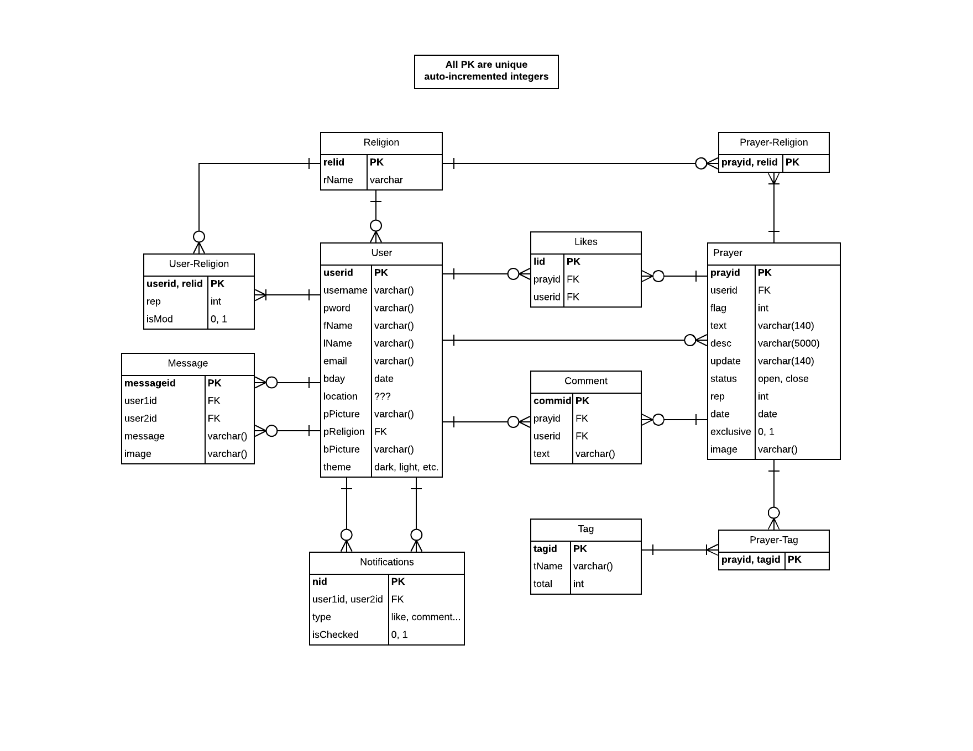
ERD

Slide 5
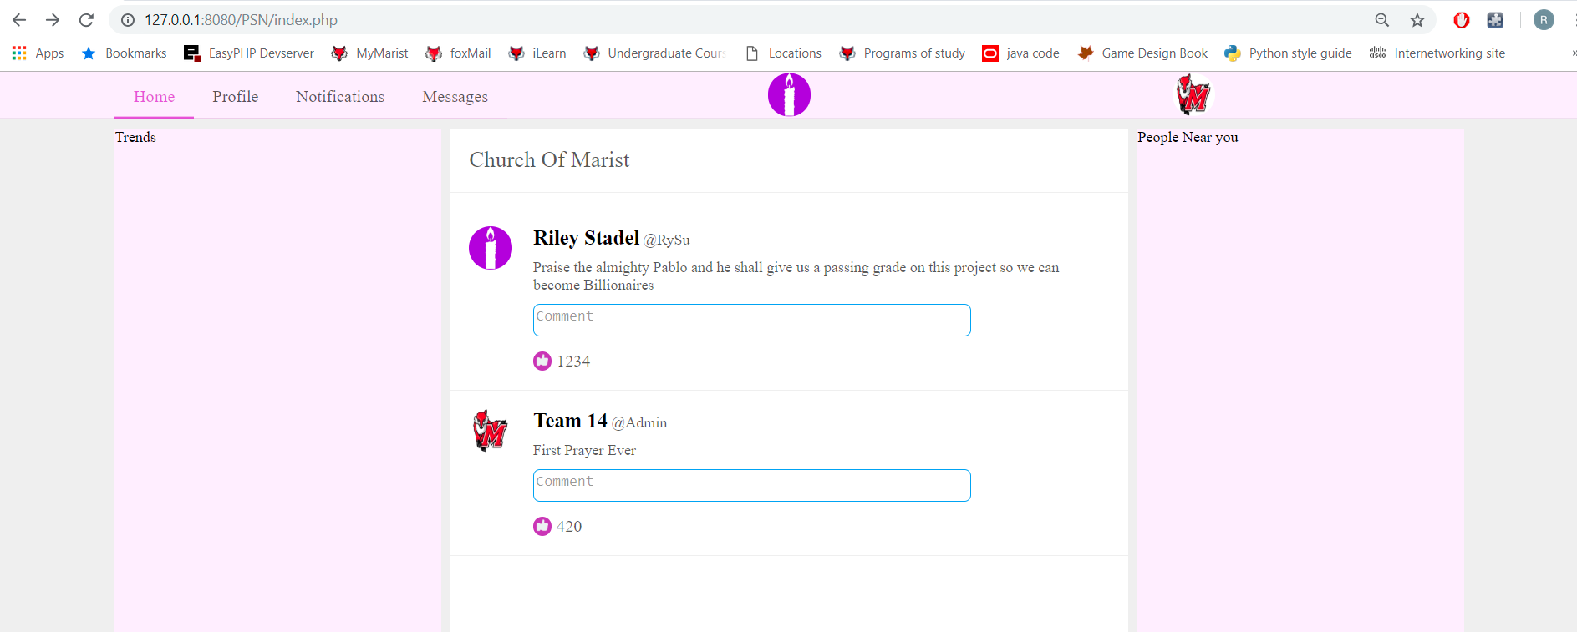
Sneak Peek

